Slide 1
Introduction to Materials Science
Day 3:
YALE PATHWAYS TO SCIENCE SUMMER WORKSHOP 2021
Aakash Kumar
aakash.kumar@yale.edu
DESIGN OF NEW MATERIALS USING SUPERCOMPUTERS

Slide 2
LEARNING GOALS
What is a material? Why is it important to study Materials Science?
What is a crystal and its unit-cell?
What is a defect? Why is it important?

Slide 3
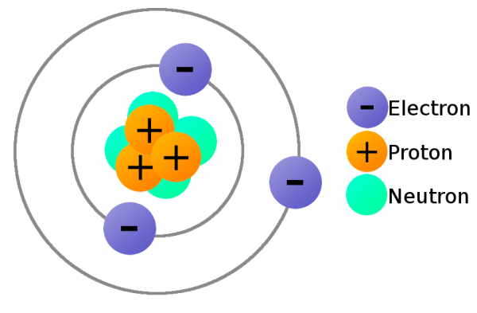
DEFINITION OF A MATERIAL
Activity: Name an object/material you can see around you?
Can you tell what it is made of?
QUIZ: Which of the following is an element?
A) Wood
B) Steel
C) Salt
D) Iron
An element is a pure substance that has atoms with the same number of protons in its nuclei
Notes:
Some historical figures

Slide 4
DEFINITION OF A MATERIAL
Activity: Name an object/material you can see around you?
Can you tell what it is made of?
QUIZ: Which of the following is an element?
A) Wood
B) Steel
C) Salt
D) Iron
An element is a pure substance that has atoms with the same number of protons in its nuclei
Notes:
Some historical figures

Slide 5
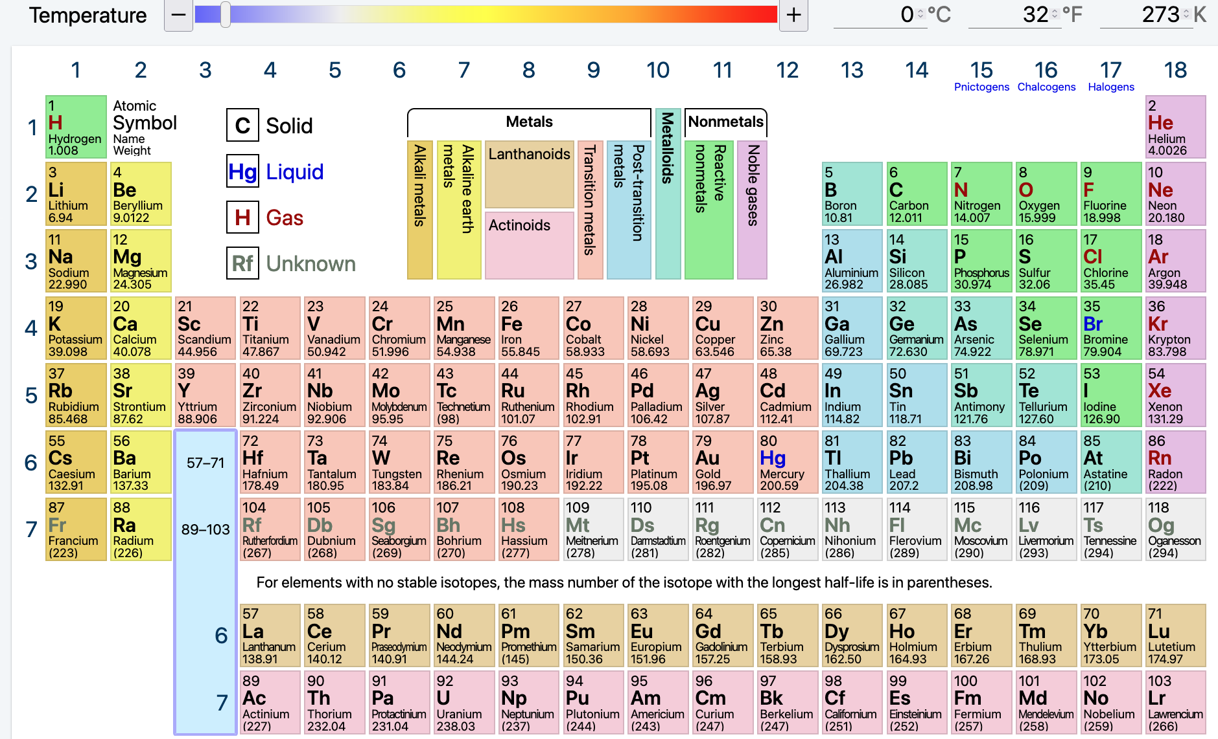
COMMON MATERIALS
Periodic table lists all known ‘elements’
Elements form ‘compounds’
Example of Compound: H₂O
We drink water, breathe in O₂,
exhale CO₂
We use materials for all our
daily applications!!
Electric wires: metals
breakfast cereal: ceramic
Notes:
Some historical figures

Slide 6
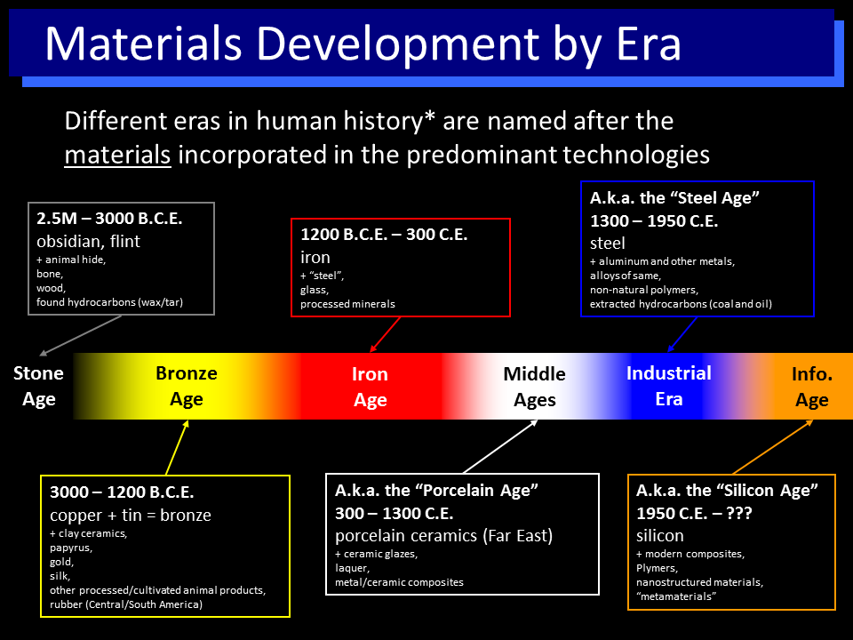
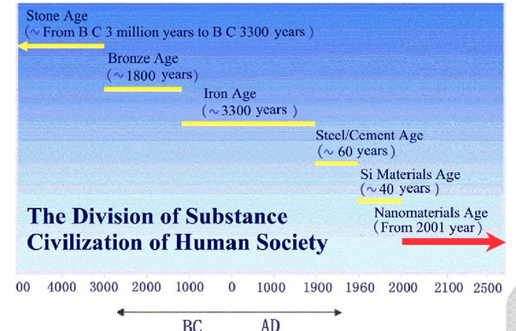
PROGRESS OF OUR CIVILIZATION
https://www.cpp.edu/~jbputhoff/history.html
Human progress has been determined
by the development of materials
The information age is driven by silicon
Nanomaterials can impact all technology
(more on this shortly)
Bangwei, Z., Arts and Social Sciences Journal (2011)
Notes:
Some historical figures

Slide 7
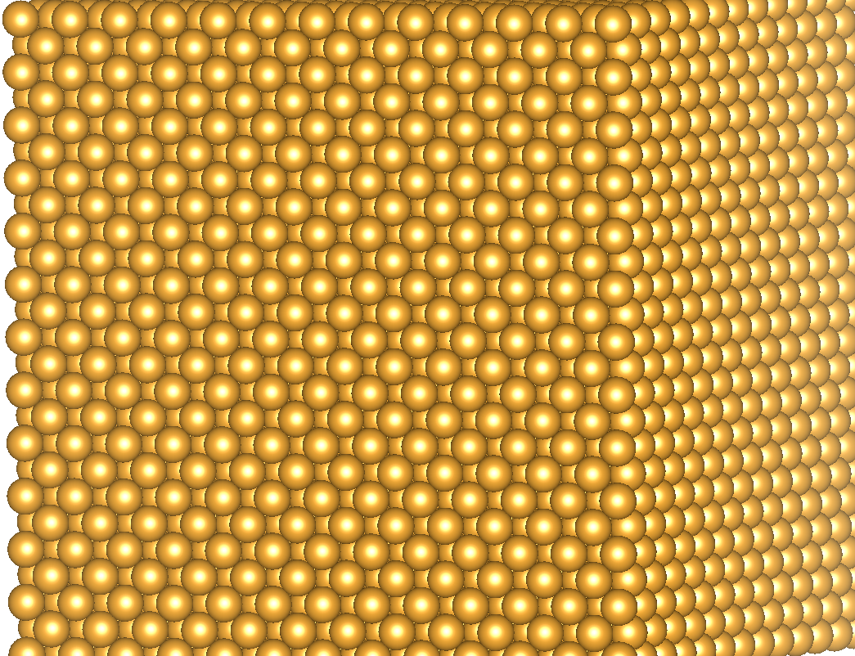
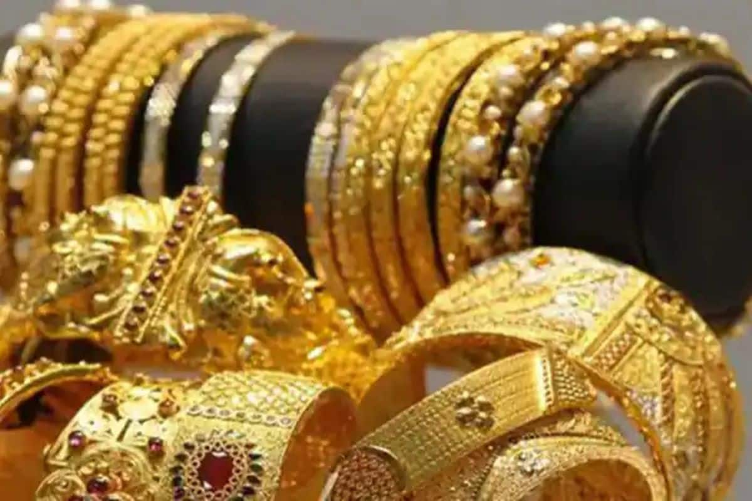
GOLD
Activity: Type the chemical symbol of Gold
Gold Crystal
Gold jewellery
Notes:
Some historical figures

Slide 8
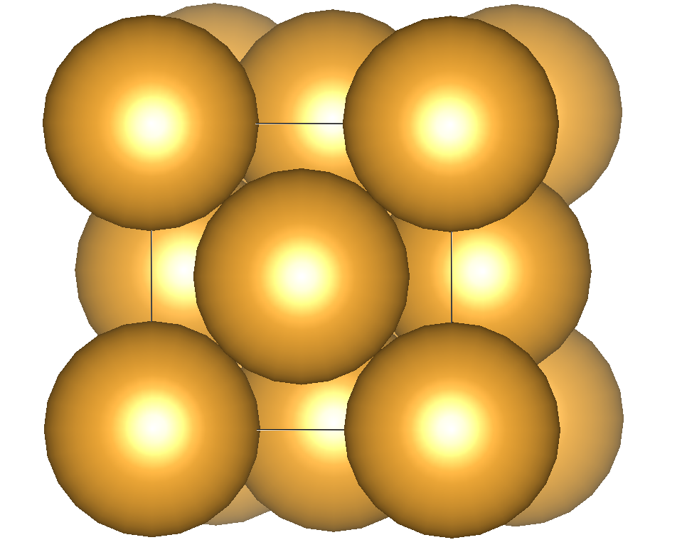
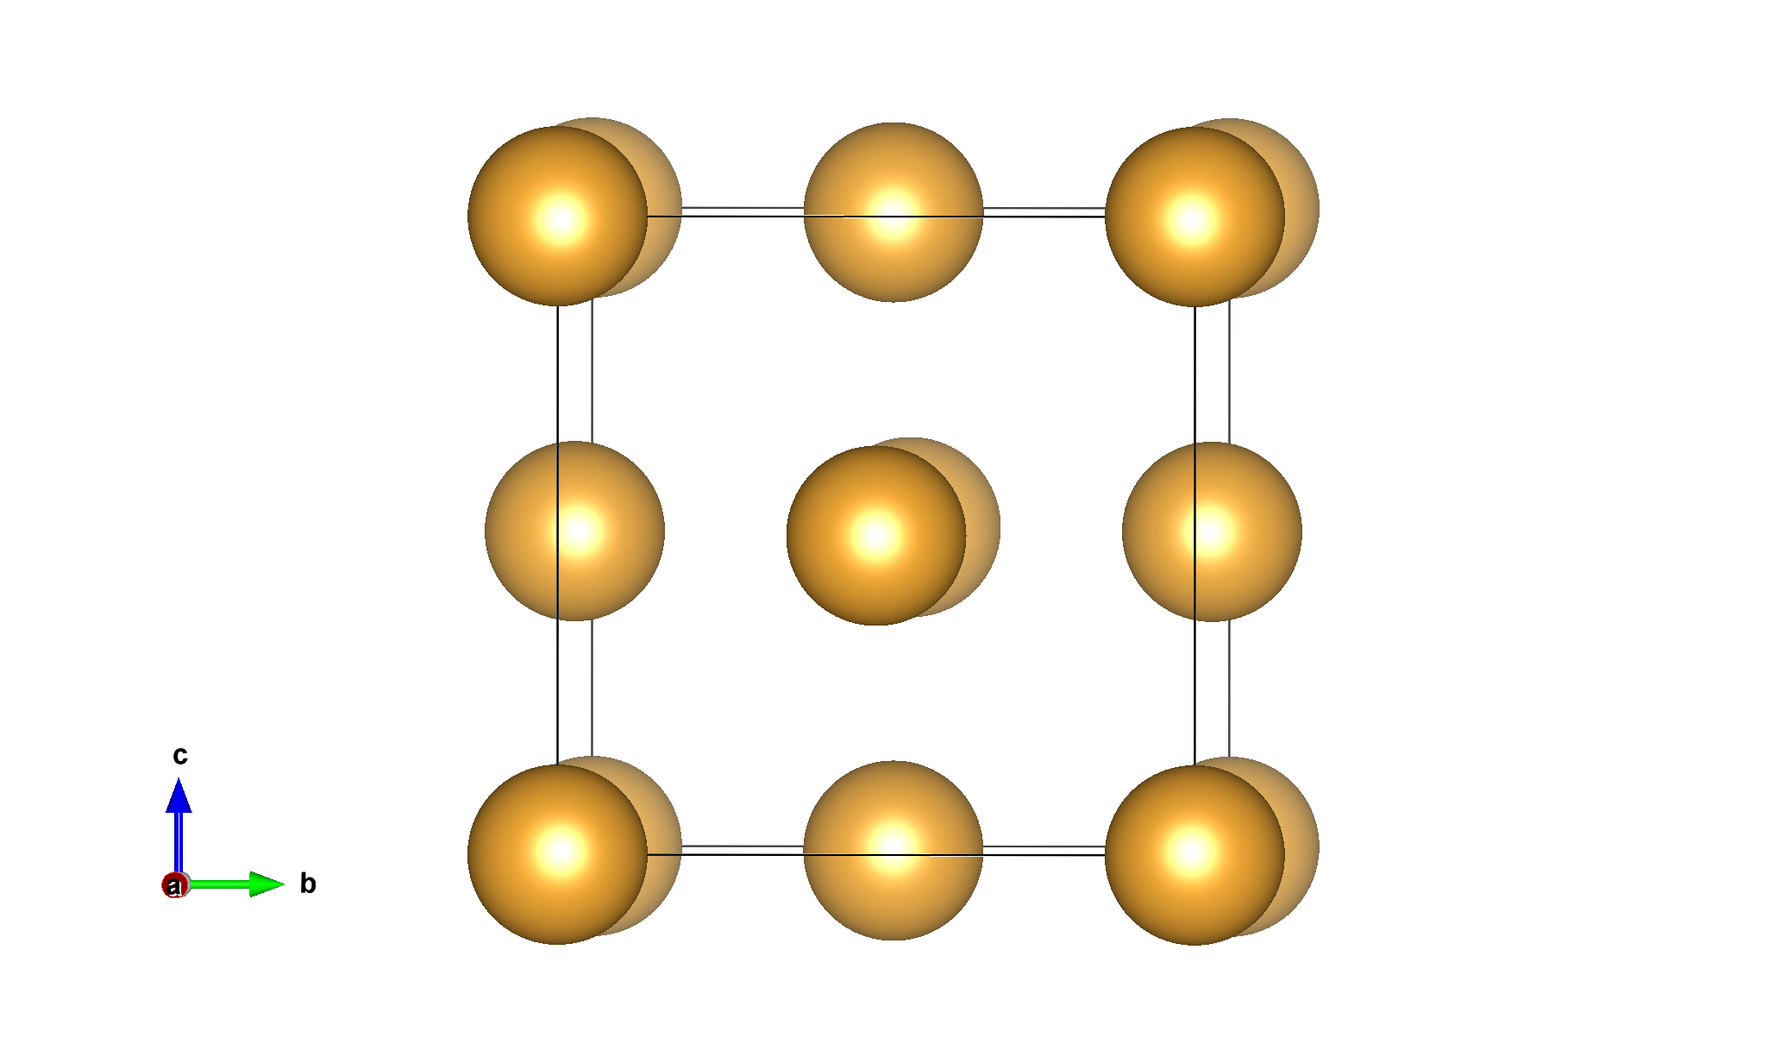
CRYSTAL STRUCTURE
Properties of Crystal:
three-dimensional (3D) repeating
ordered arrangement
How do we simplify this large structure?
Unit-cell
-smallest repeating unit which gives us the crystal structure
Notes:
Some historical figures

Slide 9
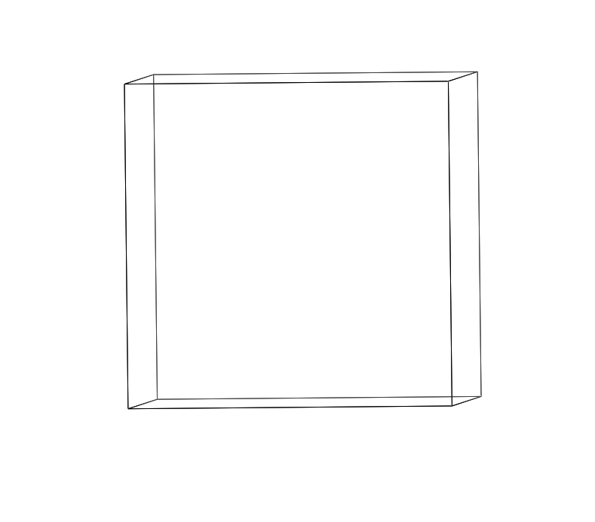
Au CRYSTAL STRUCTURE
Properties of Crystal:
three-dimensional (3D) repeating
ordered arrangement
How do we simplify this large structure?
Unit-cell
-smallest repeating unit which gives us the crystal structure
For gold, the structure is face-centered cubic (fcc)
- Atoms at corners of the cube
- Atoms at face-centers
We will use VESTA to visualize the structures! (Hands-on)
Notes:
Some historical figures

Slide 10
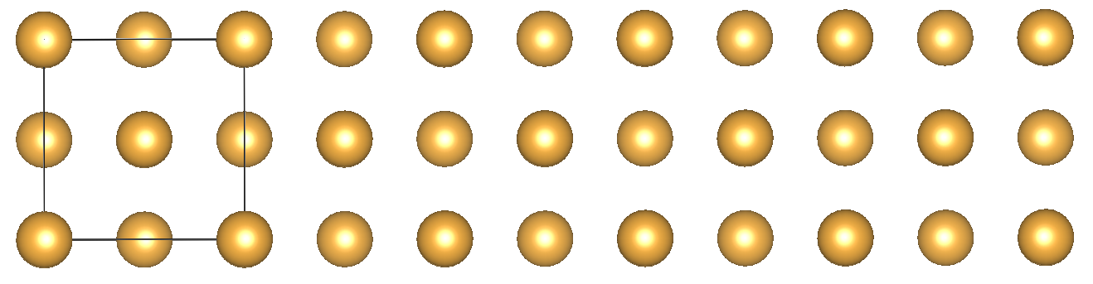
LATTICE PARAMETER
Lattice parameter (a) is an important characteristic of unit-cell
usually in Å units. 1 Å = 10⁻¹⁰ m
For Au, a_Au = 4.08 Å
QUIZ: What is the length of 5 unit-cells of Au?
A) 12.24 Å
B) 8.16 Å
C) 20.4 Å
D) 2.04 nm (nanometer, 10⁻⁹ m)
a_Au
Notes:
Some historical figures

Slide 11
LATTICE PARAMETER
Lattice parameter (a) is an important characteristic of unit-cell
usually in Å units. 1 Å = 10⁻¹⁰ m
For Au, a_Au = 4.08 Å
QUIZ: What is the length of 5 unit-cells of Au?
A) 12.24 Å
B) 8.16 Å
C) 20.4 Å
D) 2.04 nm (nanometer, 10⁻⁹ m)
Nanotechnology is the engineering of materials at nano scale!
a_Au
Notes:
Some historical figures

Slide 12
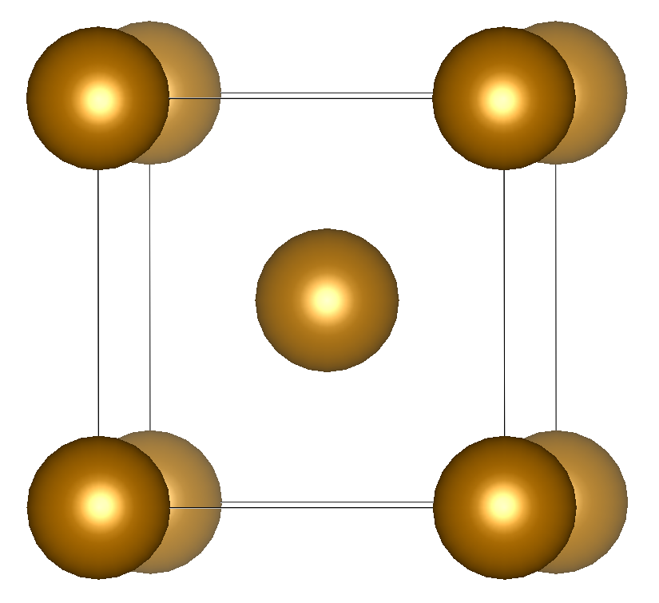
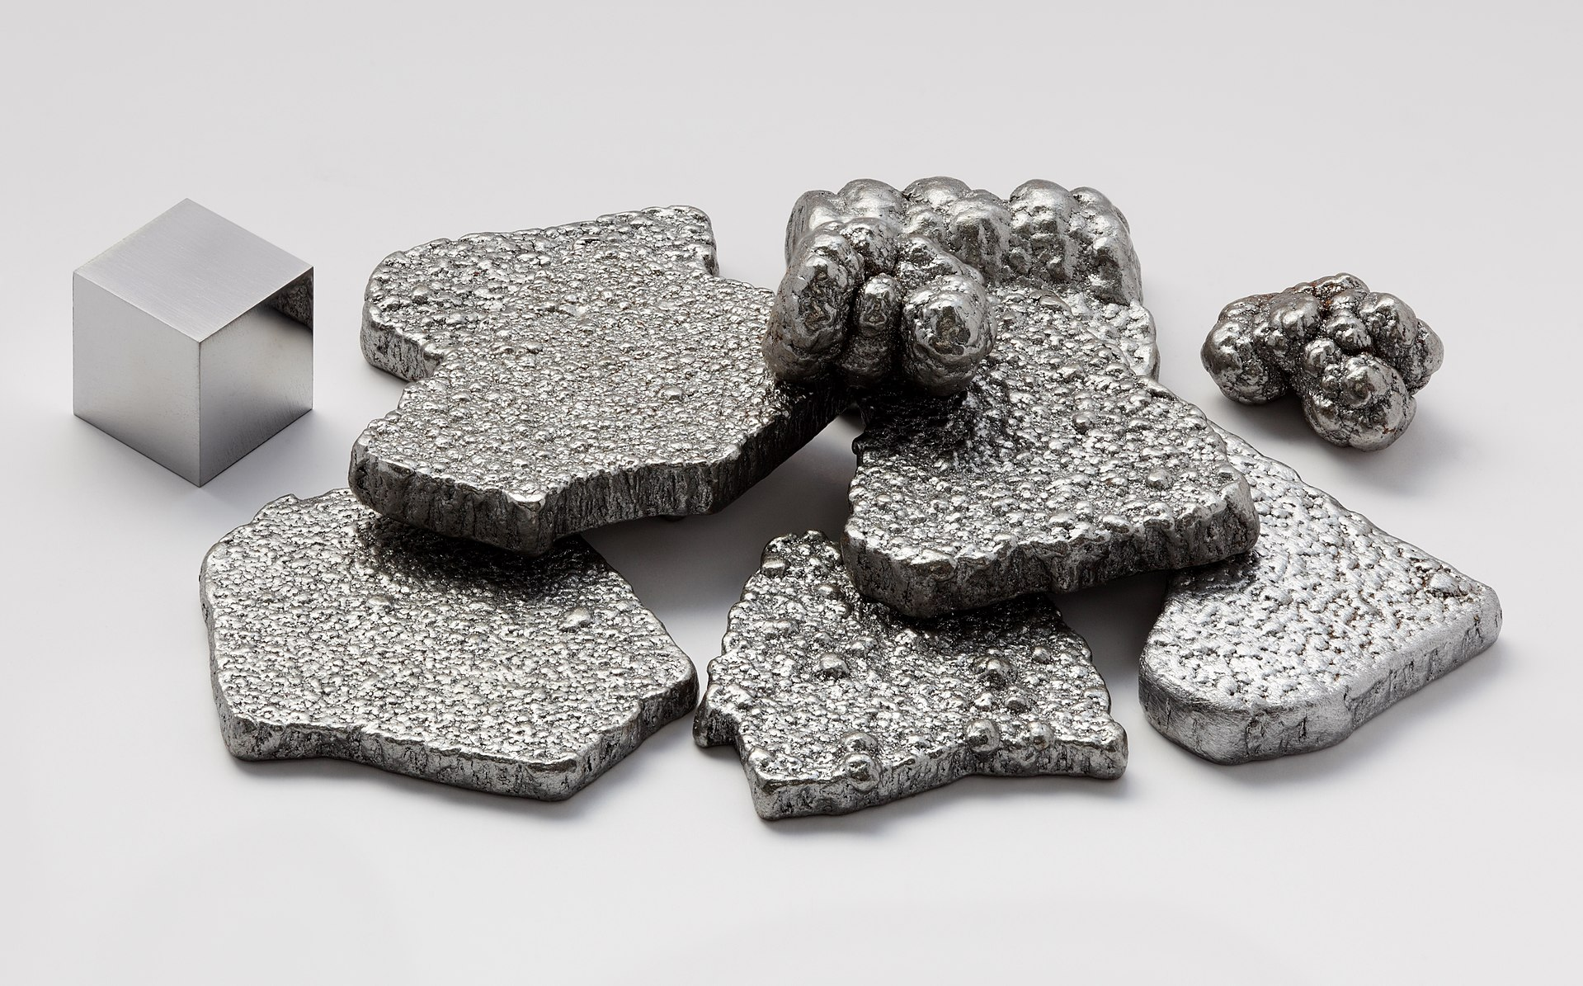
Iron
Activity: Type the chemical symbol of Iron

Slide 13
Fe CRYSTAL STRUCTURE
For iron, the structure is body-centered cubic (bcc)
- Atoms at corners of the cube
- Atoms at center of the cube
Lattice parameter (a)
For Fe, a_Fe = 2.87 Å
We will use VESTA to visualize the structures! (Hands-on)
a_Fe
Notes:
Some historical figures

Slide 14
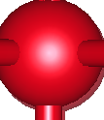
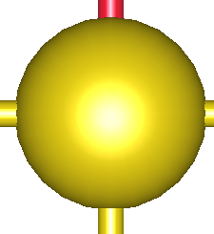
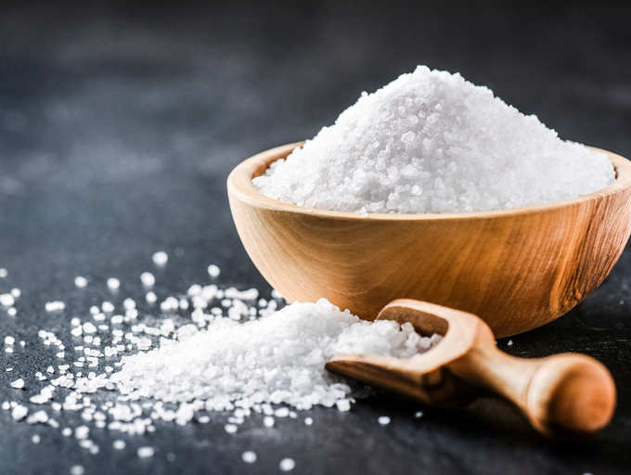
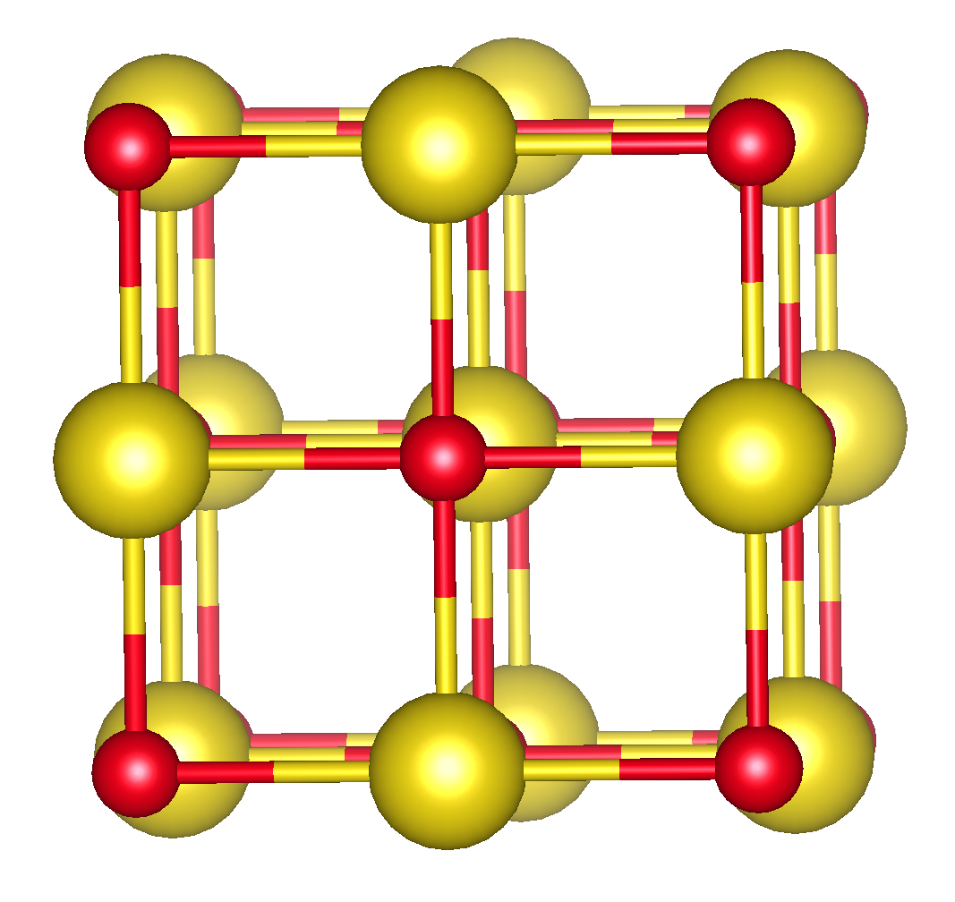
Common Salt
Na
Cl
Activity: What is the chemical formula of common salt?
NaCl is a compound made of Na and Cl elements
This structure is actually known as rocksalt structure
Lattice parameter (a), a_NaCl = 5.64 Å
a_NaCl

Slide 15
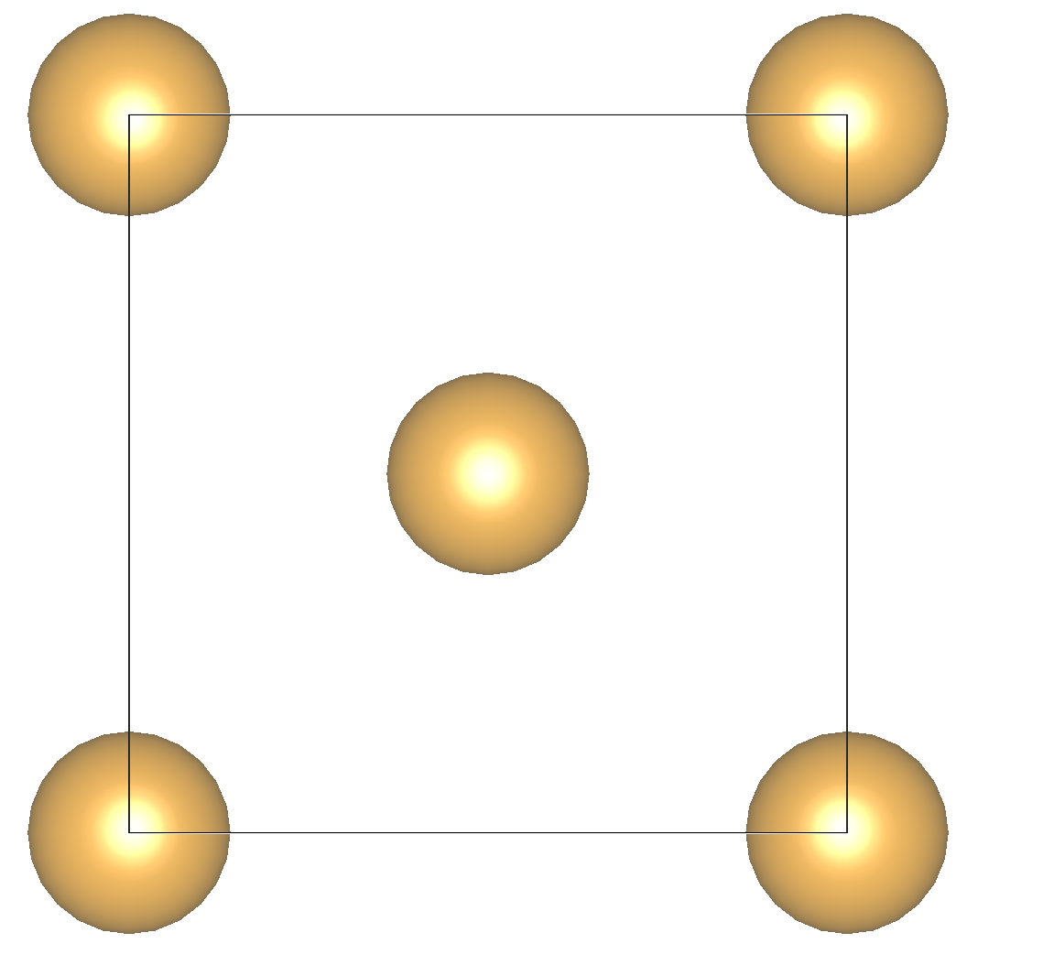
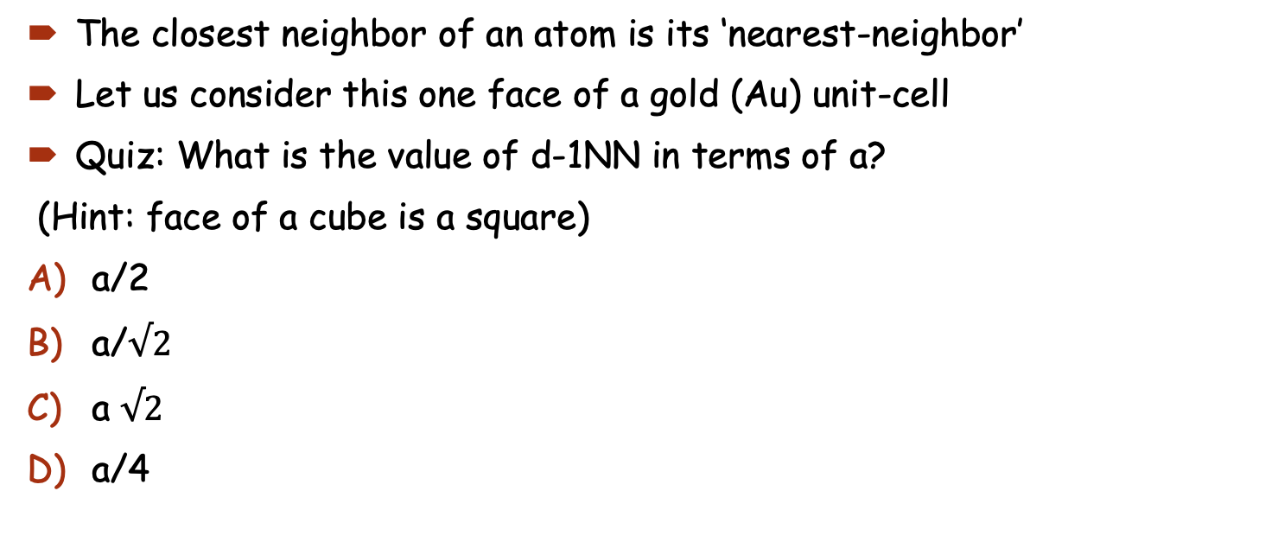
NEAREST-NEIGHBORS
The closest neighbor of an atom is its ‘nearest-neighbor’
Let us consider this one face of a gold (Au) unit-cell
Quiz: What is the value of d-1NN in terms of a?
(Hint: face of a cube is a square)
a/2
a/$√2$
a $√2$
a/4
a_Au
d-1NN
a_Au
Notes:
Some historical figures

Slide 16
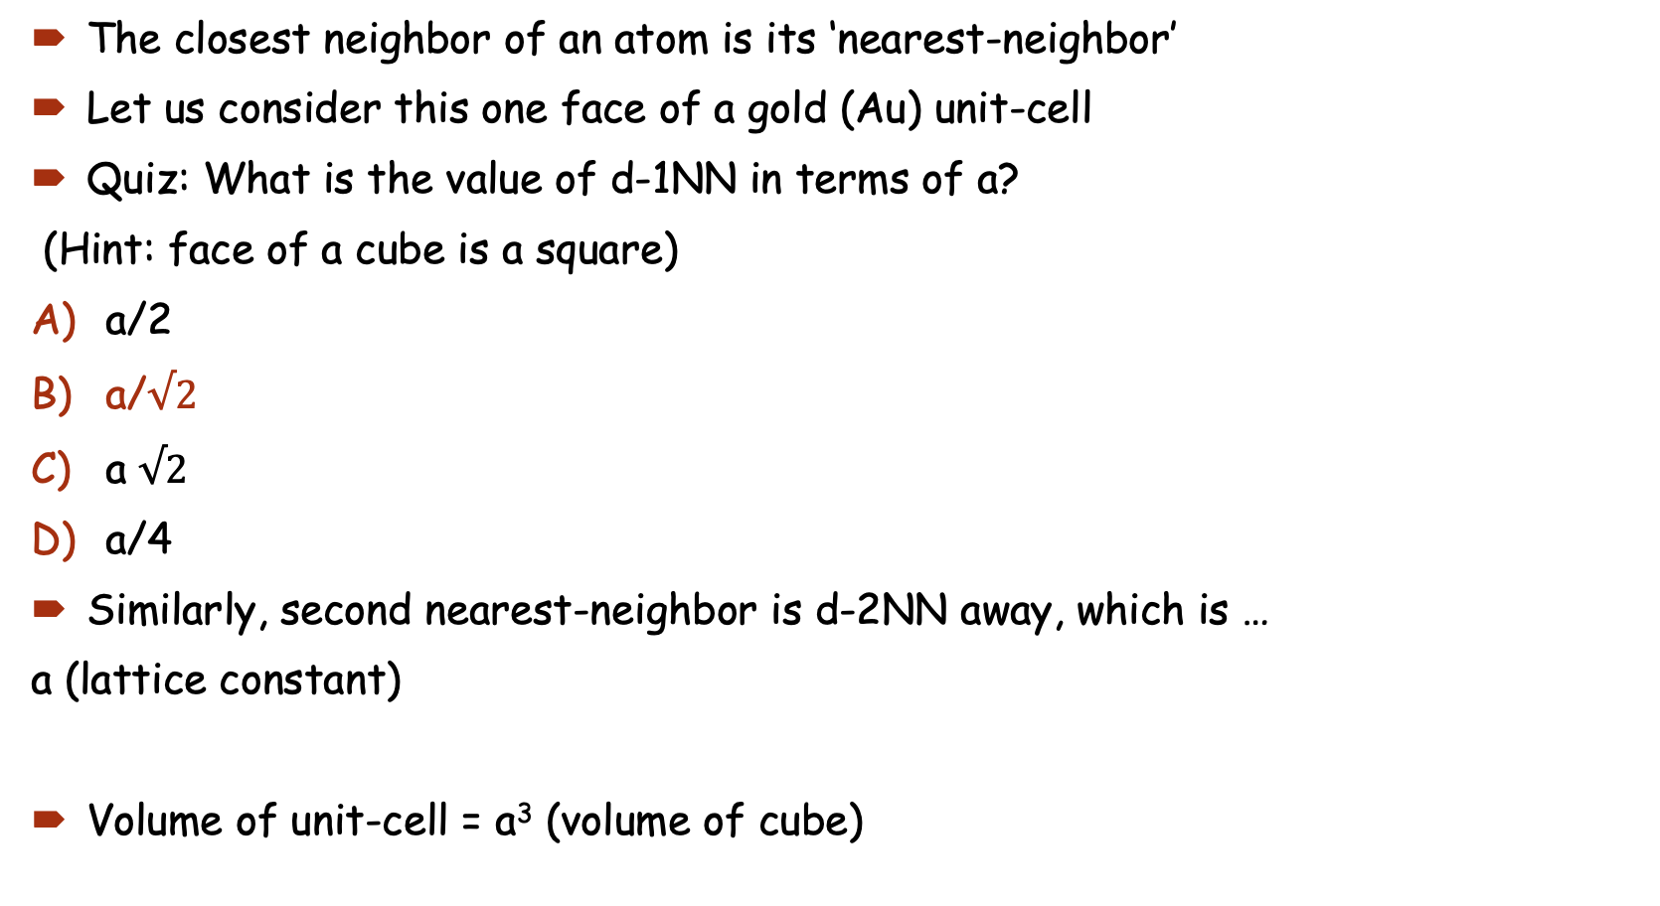
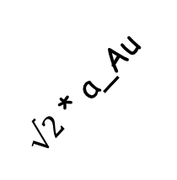
NEAREST-NEIGHBORS
The closest neighbor of an atom is its ‘nearest-neighbor’
Let us consider this one face of a gold (Au) unit-cell
Quiz: What is the value of d-1NN in terms of a?
(Hint: face of a cube is a square)
a/2
a/$√2$
a $√2$
a/4
Similarly, second nearest-neighbor is d-2NN away, which is …
a (lattice constant)
Volume of unit-cell = a³ (volume of cube)
$√2$ * a_Au
a_Au
d-1NN
a_Au
Notes:
Some historical figures

Slide 17
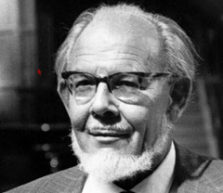
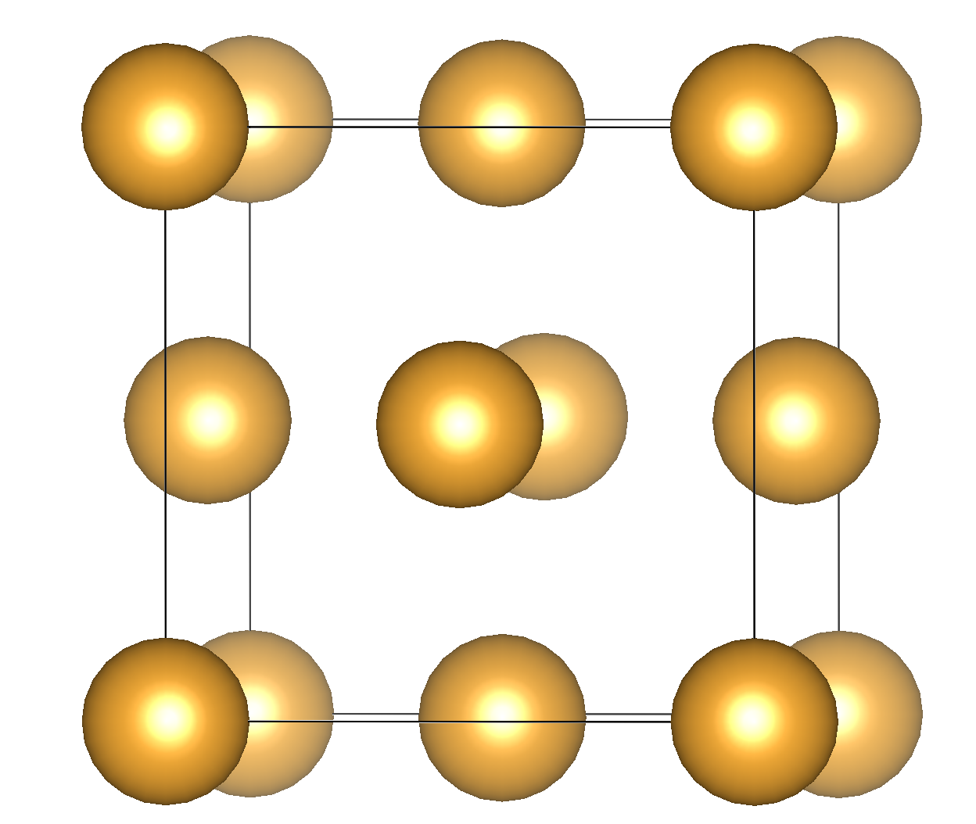
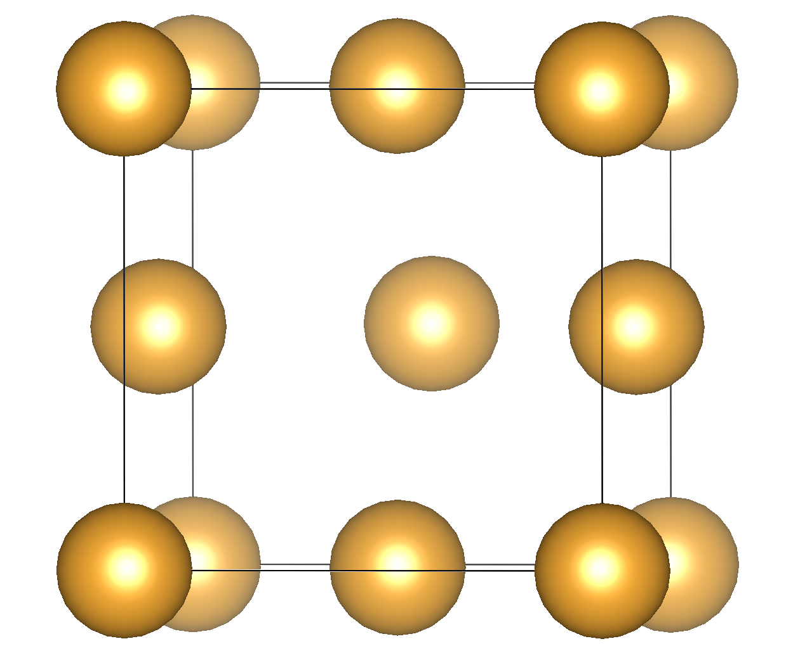
DEFECTS
The atoms do not always sit in their usual positions -> Defects
Defects are common in materials and impact the properties
“Crystals are like people: it is the defects in them that make them interesting.”
Materials Science and Engineering aims to engineer new materials
Goal is to understand defects and how they impact material properties
Charles Frank
Vacancy
Notes:
Some historical figures

Slide 18
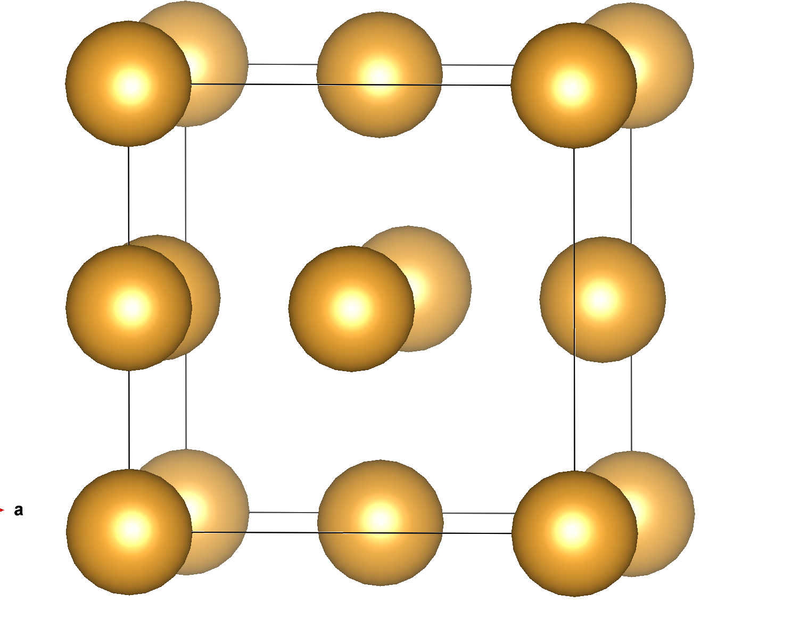
DEFECTS IN MATERIALS
Types of defects:
vacancies: atom missing from its usual site
interstitials: atom at an interstitial (void between atoms) site
Notes:
Some historical figures

Slide 19
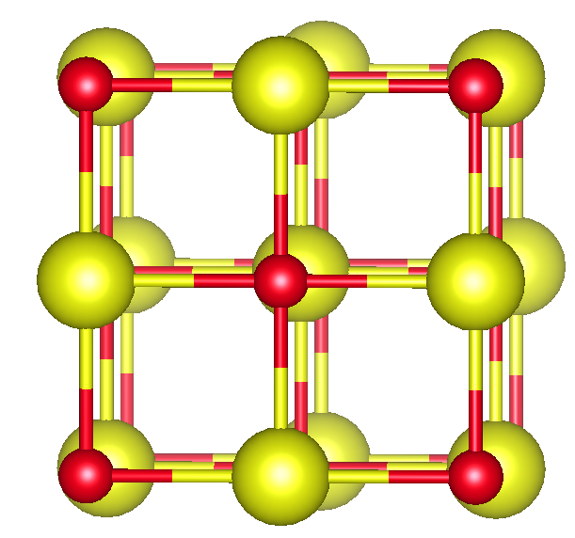
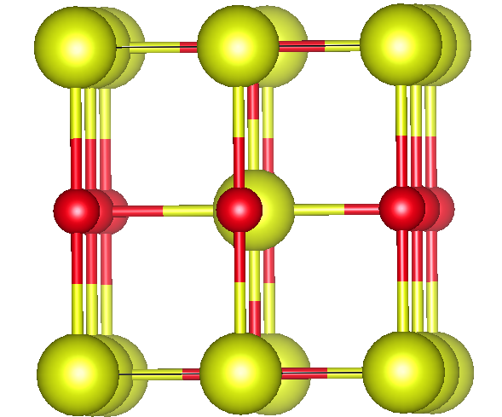
DEFECTS IN MATERIALS
Types of defects:
vacancies: atom missing from its usual site
interstitials: atom at an interstitial (void between atoms) site
antisites: different atoms (Na and Cl) swap their usual sites
Notes:
Some historical figures

Slide 20
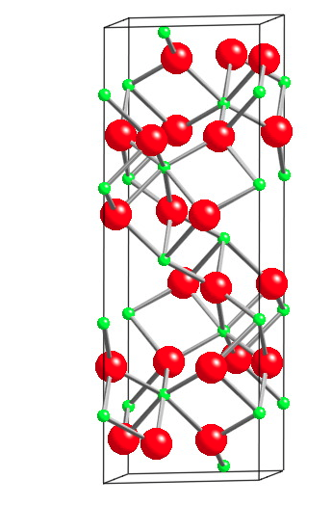
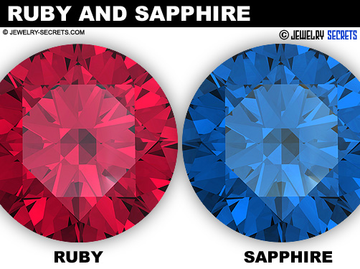
DEFECTS IN MATERIALS
Types of defects:
vacancies: atom missing from its usual site
interstitials: atom at an interstitial (void between atoms) site
antisites: different atoms (Na and Cl) swap their usual sites
Above defects are intrinsic, often we introduce defects externally these are called extrinsic defects
Si is extrinsically doped to increase the number of charge carriers!
color due to Ti and Fe
color due to Cr defects
pure Al₂O₃
(transparent)
Notes:
Some historical figures

Slide 21
KEY POINTS
Materials are everywhere around us, their development is linked to our progress
We represent a crystal structure using its unit-cell with a lattice parameter.
Defects in materials can be of intrinsic as well as extrinsic type.
Defects can play a key role to tune the desired properties of materials.
Materials Science and Engineering aims to understand materials at a fundamental level and try to design new ones by engineering defects in the material.

Slide 22
RESOURCES
https://youtu.be/dLPgqobwPGE
https://steemit.com/life/@zest/the-three-age-system-the-stone-age-the-bronze-age-and-the-iron-age
https://en.wikipedia.org/wiki/History_of_materials_science
https://www.doitpoms.ac.uk/tlplib/crystallography3/unit_cell.php
https://www.nano.gov/timeline
self-healing material (slightly older video) https://youtu.be/kX_kiECXkvM
Notes:
Some historical figures

